Slide 1


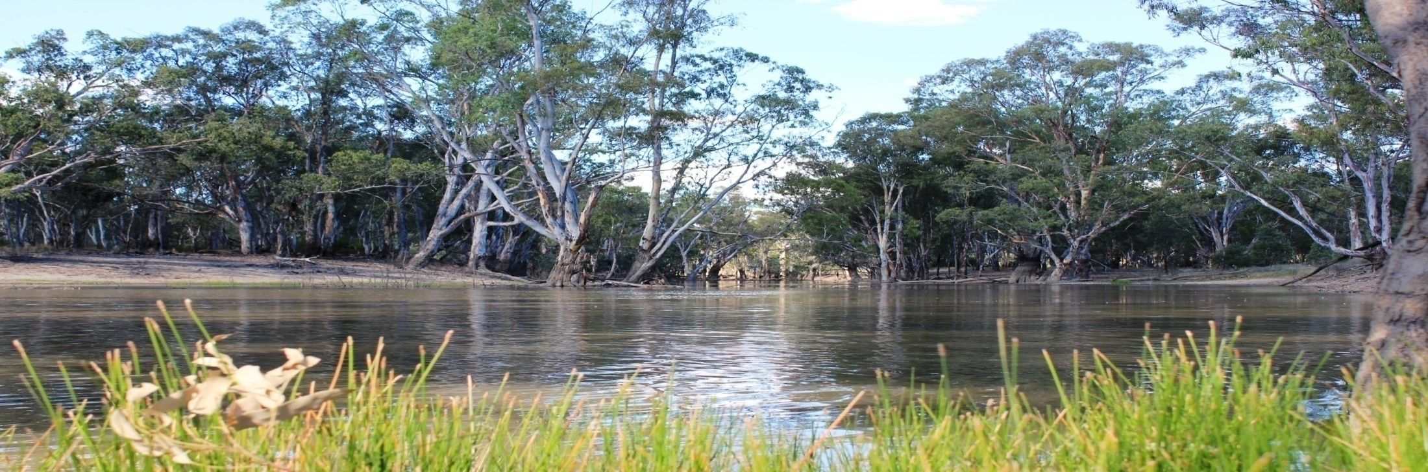

Management of Commonwealth environmental water in the Murray-Darling Basin, Australia
David Papps, Commonwealth Environmental Water Holder
Environmental Flows for Strategic Planning for the Ganga Basin Workshop,
February 5-6, 2015

Slide 2
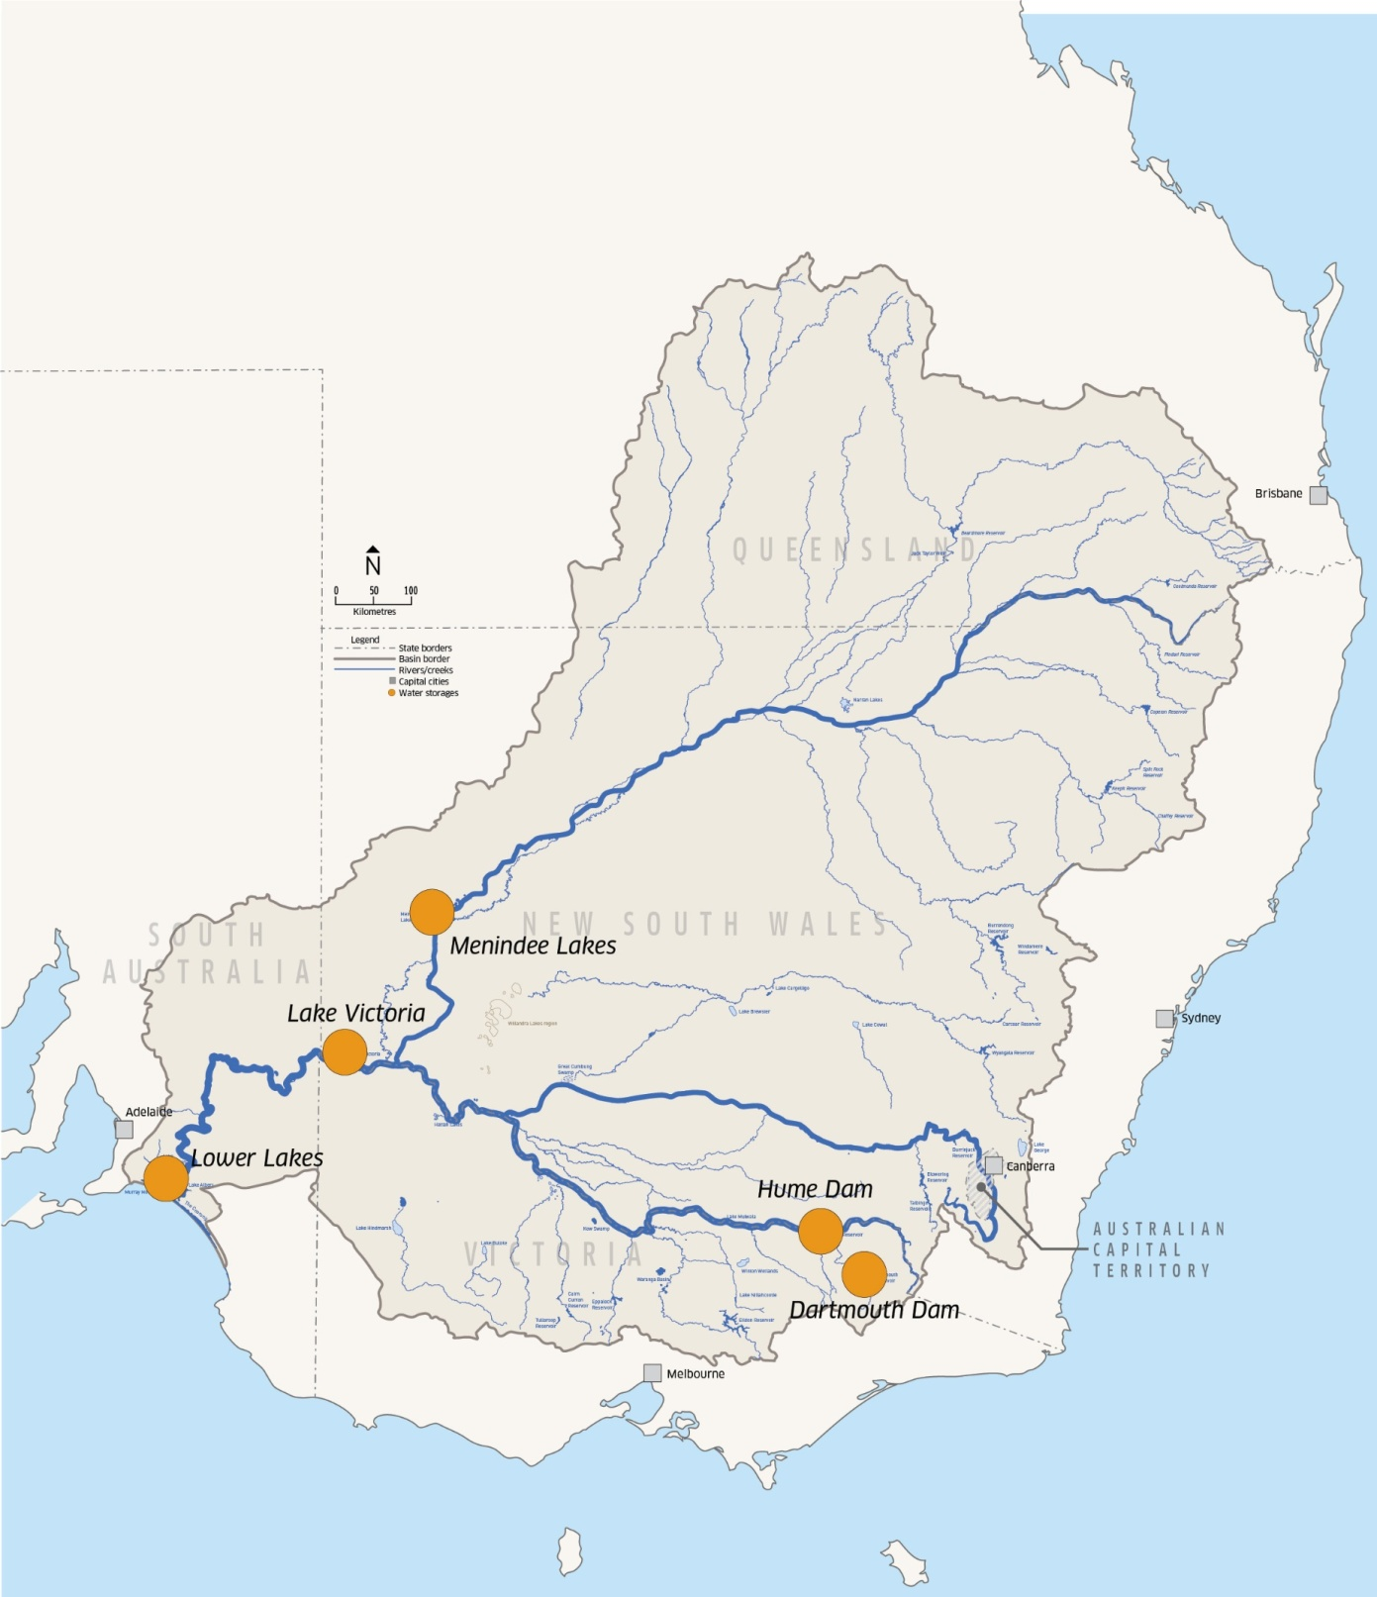
Hydrology of the Basin:
River lengths and major storage locations
Source: Murray Darling Basin Authority

Slide 3
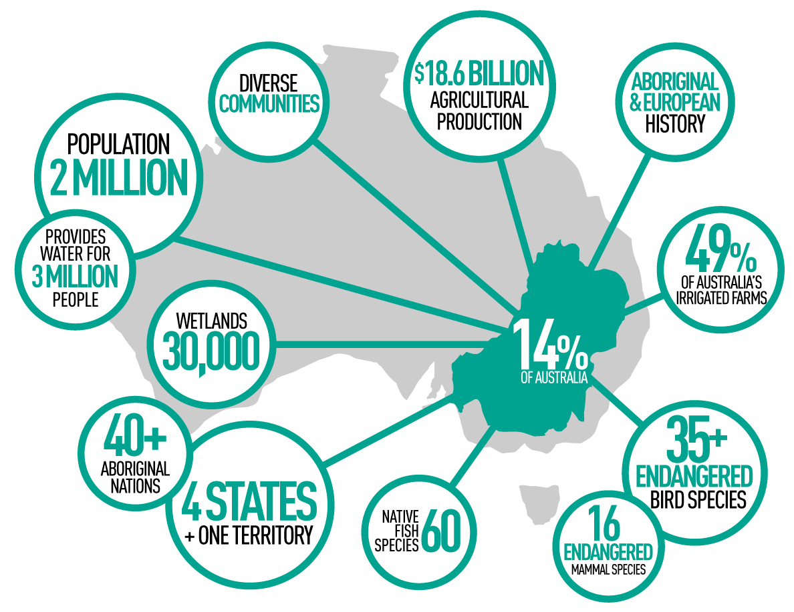
Fast facts
Source: Murray Darling Basin Authority

Slide 4
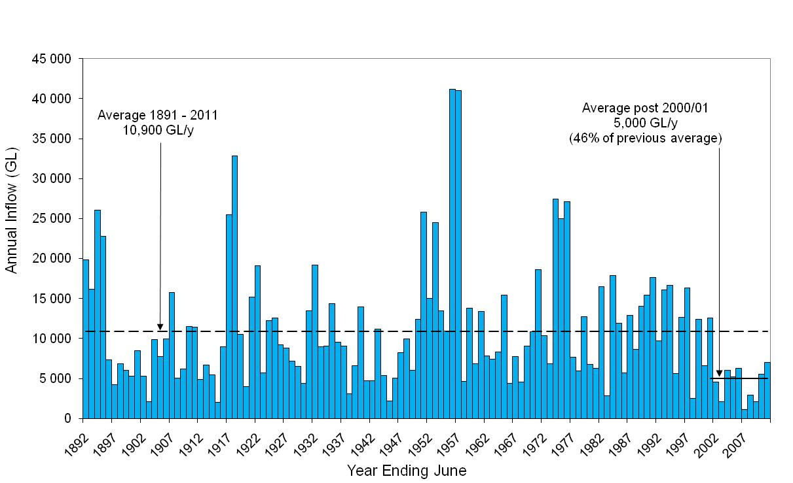
River Murray System Inflows 1891-2011
(Including Inflows to Menindee and Excluding Snowy Releases)
Source: Murray Darling Basin Authority

Slide 5
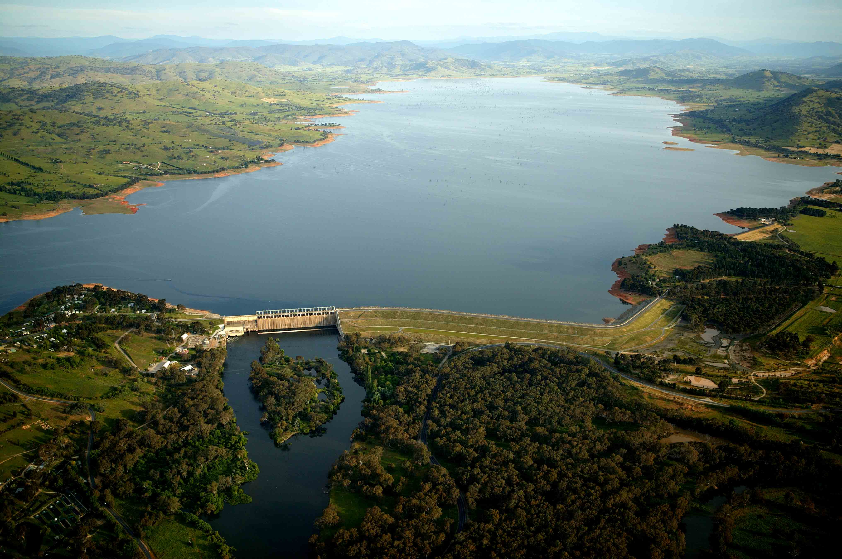
Hume Dam
3000 GL reservoir
50m high
Completed 1936 raised 1961
Main operating storage

Slide 6
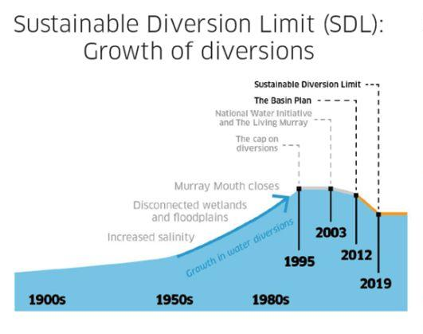

Slide 7
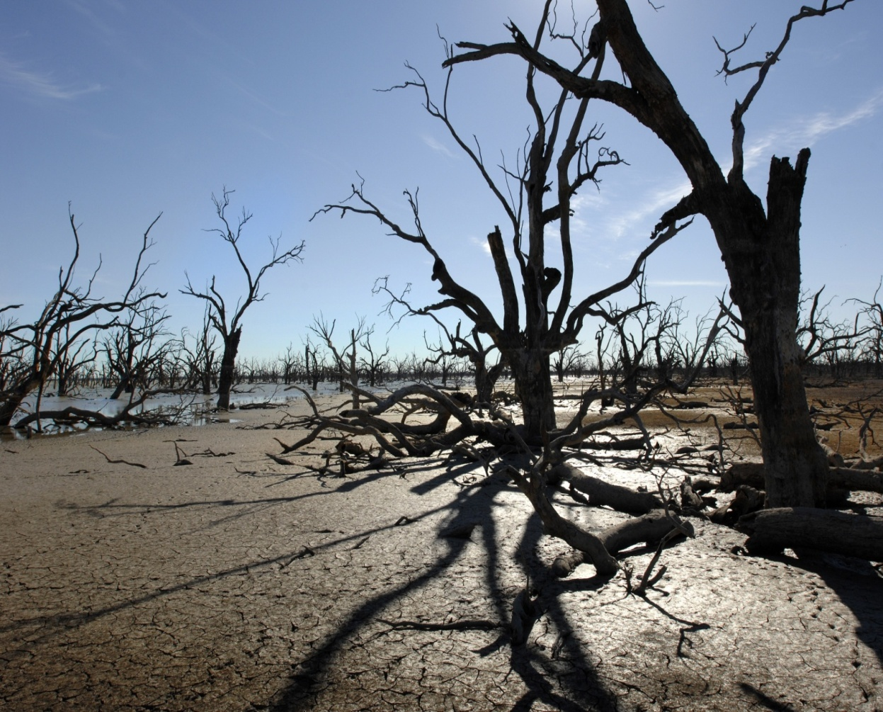
Key Reform Elements that Enabled Commonwealth Environmental Watering
acknowledging over-allocation was causing significant environmental decline
capping water use to prevent further growth
creating secure and tradeable rights to use water, known as entitlements

Slide 8
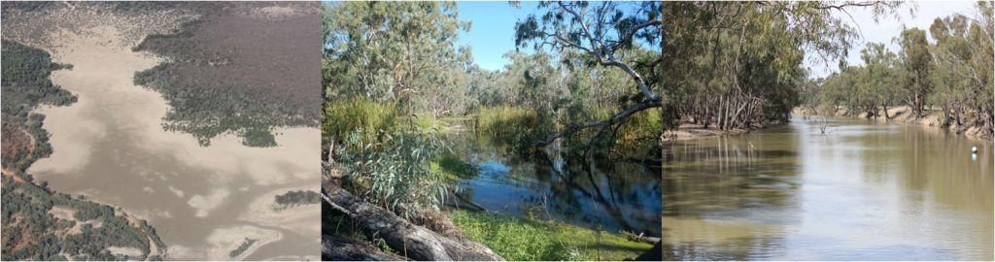
Key Reform Elements that Enabled Commonwealth Environmental Watering
developing a legally-binding plan for the integrated management of all of the Basin’s rivers, including setting new environmentally sustainable limits on water use (by an independent, expert commonwealth agency)
governments recovering water through the market and investing in water efficiencies, in order to achieve the new limits and return water to the environment
establishing a federal entity to manage the recovered (i.e. Government-owned water) for the restoration and protection of the environment

Slide 9
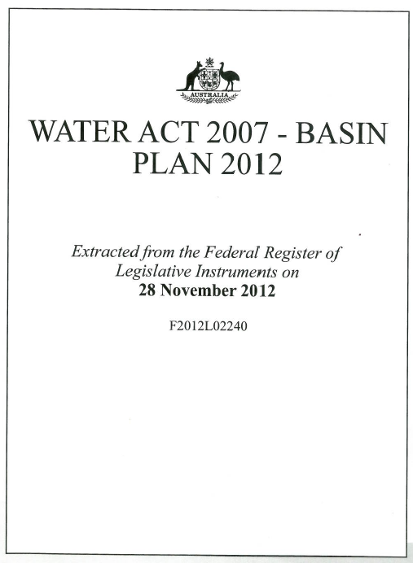
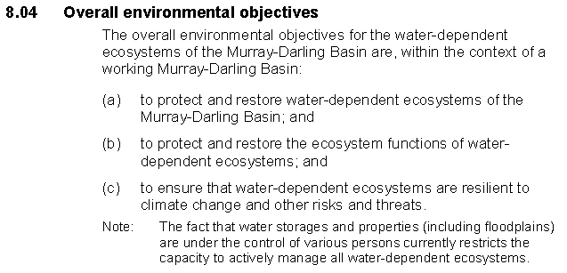
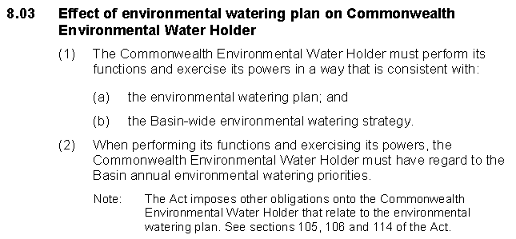
Basin Plan – Environmental Watering Plan
Common objectives
Consistent planning framework
Short and longer-term elements

Slide 10
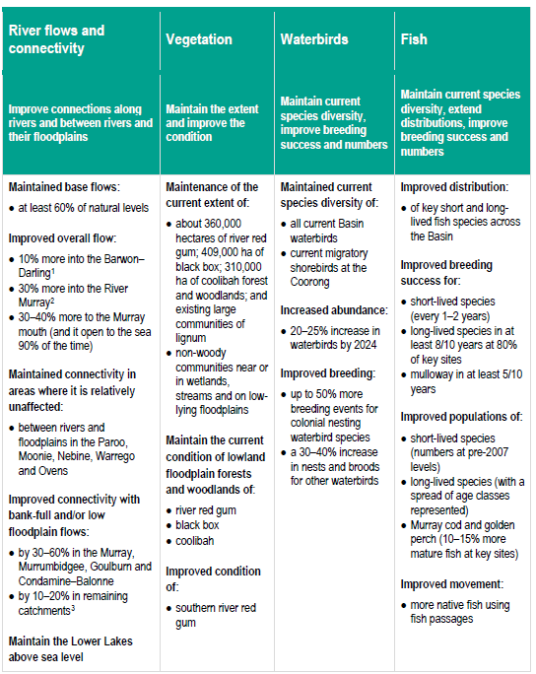
Basin Wide Strategy
describes the important environmental outcomes expected to be achieved in the long term
strategies for the management and use of water to maximise outcomes
how various partners will work together to plan and manage environmental water

Slide 11
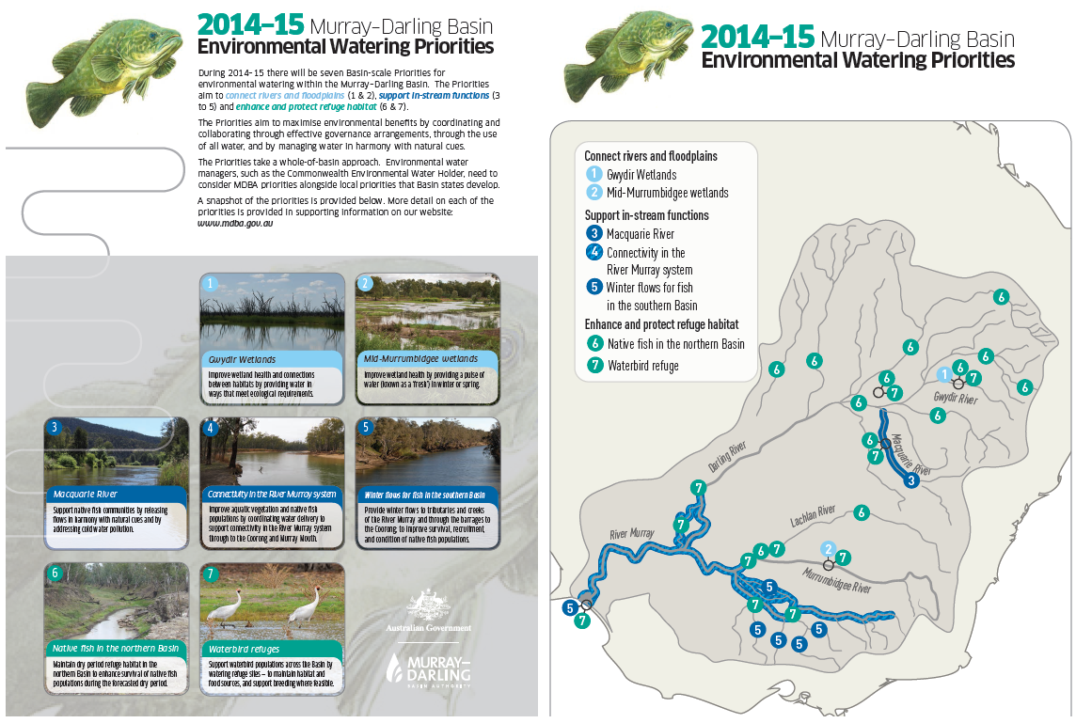
Environmental water: Annual Basin priorities

Slide 12
Responsibilities under the Basin Plan
The Basin Plan broadly confers the following responsibilities:
Murray-Darling Basin Authority is responsible for reporting on the achievement of the environmental objectives of the Basin Plan at a Basin scale
Basin States are responsible for reporting on the achievement of environmental objectives of the Basin Plan at an asset scale
Commonwealth Environmental Water Holder is responsible for reporting on the contribution of Commonwealth environmental water to the environmental objectives of the Basin Plan.

Slide 13
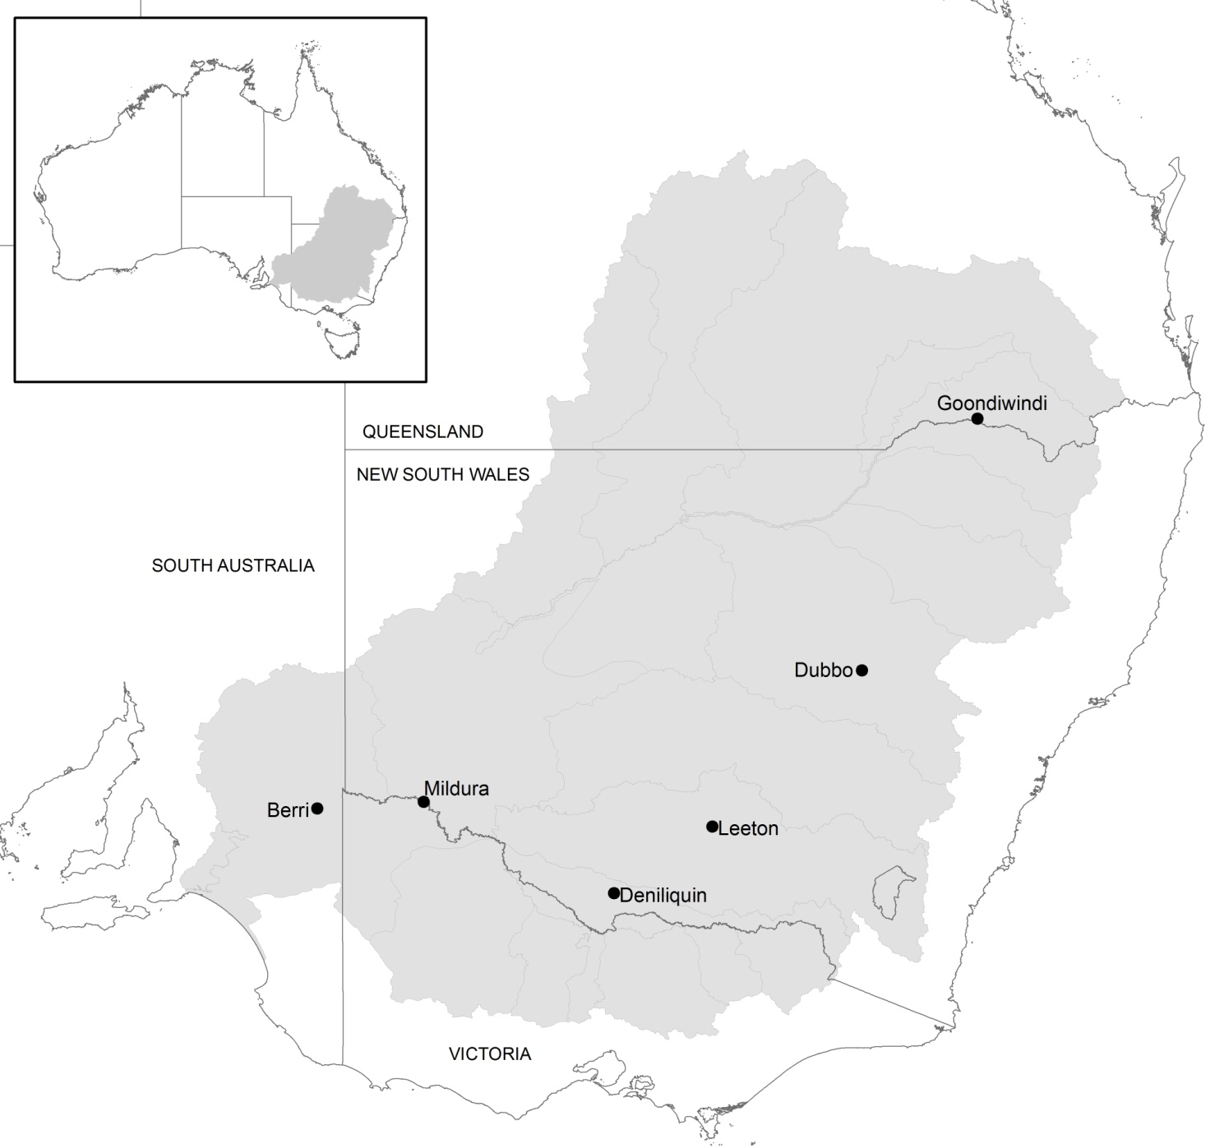
CEWO Monitoring and Evaluation
Framework linking Basin Plan Objectives to shorter-term outcomes
Monitoring detailed ecological response to environmental watering in seven areas
Complementing areas monitored by others
Models used to extrapolate results to areas not monitored
Evaluation of basin-wide outcomes
Junction of Warrego and Darling
Gwydir river system
Lower Murray River
Murrumbidgee river system
Lachlan river system
Edward-Wakool river system
Goulburn river system

Slide 14
A range of indicators are used
 | Benefits immediately observable |  | Delay between e-water action and observed benefits
Directly attributable to e-water | Hydrology | Inundation | Water Quality
 | Vegetation greenness (condition) | Vegetation extent | Vegetation recruitment (population demographics)
Influenced by other factors | Native fish recruitment | Waterbird recruitment | Fish and bird population viability, resilience

Slide 15
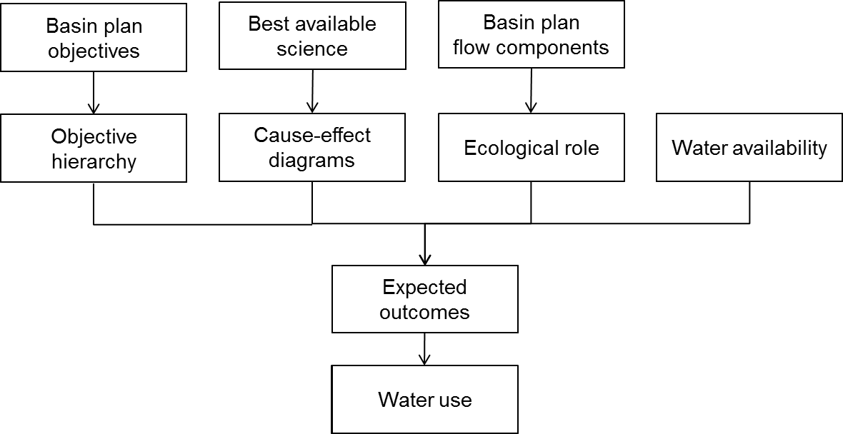
Developing Expected Outcomes

Slide 16
Outcomes Framework
Basin Plan Objectives
Biodiversity
Ecosystem Function
Resilience
Water Quality
Level 1
Ecosystem diversity
Connectivity
Process
Ecosystem
Chemical
Biological
Level 2
Species diversity
Population
Notes:
Common thread is environmental objectives of the Basin Plan
Need to translate what this means down to the level of monitoring programs.
Objectives hierarchy helps us do that
These relationships provide the logic for how actions at a site scale contribute to the EWP objectives.
Even without M&E we can infer outcomes using this logic – helps us bring together info on e-watering from lots of disparate sources and make sense of them.
Powerful way of inferring/demonstrating how e-watering contributes to the objectives of the Basin Plan
This approach also helps articulate the role of e-watering and manage expectations – it tells us about the results we are likely to see at different stages.
Importantly, the logic is supported by more detailed cause and effect diagrams that will come supported with a literature review.
Can look at the cause and effect diagram for water quality on the NEXT SLIDE

Slide 17
Cause and Effect Models – water quality
Level 1
Objective
Ecosystem Types
Water quality
River
Wetland
Floodplain
Level 2
Objectives
Chemical
Biological
Salinity
Algal blooms
Related cause and effect models
pH
Dissolved oxygen

Slide 18
Focus on ‘evaluation’
Evaluation in this project will seek to identify and quantify:
  the extent to which the expected outcomes of Commonwealth environmental watering have been achieved
  the contribution of Commonwealth environmental water to the objectives of the Basin Plan.
The Area evaluation will focus on the achievement of 1 year and 5 year outcomes, with reference to Basin objectives using the outcomes framework
The Basin evaluation will focus on the contribution to Basin Plan objectives, with reference to demonstrated 1 year and 5 year outcomes

Slide 19
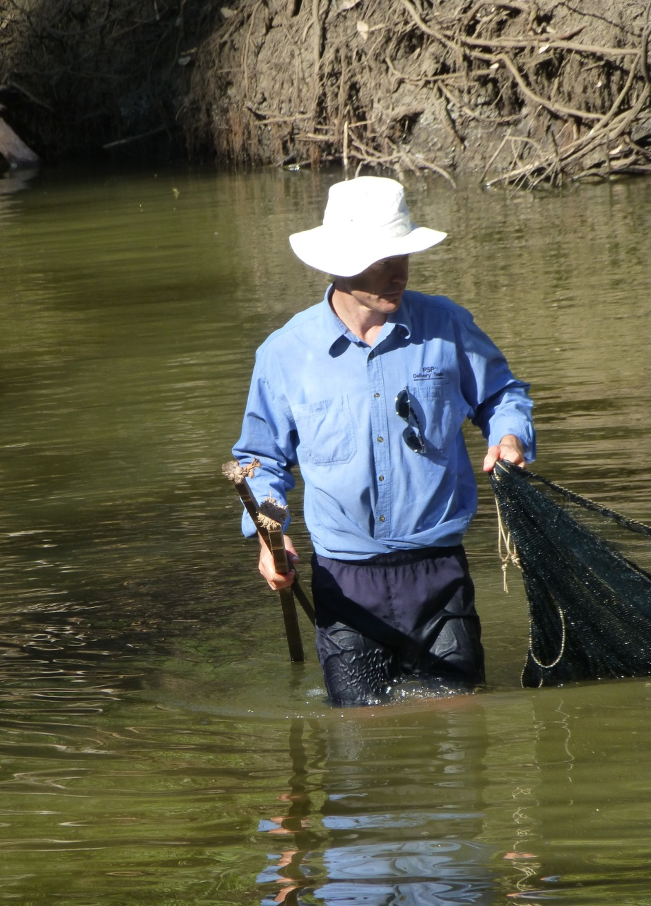
Community engagement
Consulting early and often – including the community in the early planning and design stage
Ongoing role for local interest and community groups to create ownership
Accessing local knowledge and experience
Regular updates and information sharing
Getting to know the people involved and who depend on the river systems for their livelihood
Demonstrating outcomes

Slide 20
Implementation Challenges
There is an ongoing need to balance scope and budget within a world where different stakeholders have different views about what and how to monitor.
  Compromises have been made, particularly between monitoring of parameters which help to understand basin-scale outcomes and those which are useful for informing local scale management.
Ensuring coordinated and integrated monitoring between Federal and State agencies will be an ongoing challenge.
  There is much work to do to ensure that monitoring is fit-for-purpose to support the MDBA to undertake its Basin wide evaluation.
Communicating the results in a way which resonates with communities
  People want to see monitoring results quickly and in a way that reflects their own local interests and values rather than necessarily monitoring based on science to support a larger basin-wide program.

